Slide 1




Presented By
Basant Saad Eldin
DAILY AI UPDATES
www.linkedin.com/in/basant-saad-eldin

Slide 2

The Challenge in AI News
Information
Expensive Solutions
100+ AI updates daily across multiple platforms
Premium news services cost $450+/month
Manual Monitoring
No Analysis
Hours spent checking multiple sources daily
Raw data without insights or actionable takeaways
Notes:
1

Slide 3

Our Solution
An intelligent automation system that works while you sleep
COLLECT
Aggregates AI news from 7+ sources in parallel: arXiv, Hugging Face, GitHub, Reddit, Papers with Code, and company blogs
ANALYZE
Gemini AI processes all data to create executive summaries, trend analysis, breakthrough tech highlights, and actionable insights
DELIVER
Beautiful HTML email reports delivered daily with categorized updates, priority levels, and direct links to sources

Slide 4

Key Features
🌐
7+ Real-Time Sources
🧠
Gemini AI Analysis
📧
Beautiful Email Reports
Comprehensive coverage across research, models, tools, and news
Deep insights, trends, and predictions powered by advanced AI
Professional HTML design with priority levels and categories
⚡
Parallel Processing
🔄
Automated Scheduling
Fast execution with concurrent data retrieval
Daily, weekly, or custom intervals with background execution
Notes:
5

Slide 5
Who Benefits?
👨‍💻
AI Practitioners
💼
Business Leaders
Stay current with latest models, techniques, and research papers
Track industry trends and competitive intelligence daily
🔬
Researchers
💰
Investors
Monitor breakthrough papers and new methodologies
Identify emerging opportunities and market shifts
🎓
Students
👥
Teams
Learn about cutting-edge developments in AI field
Share curated updates with entire organization
Notes:
12

Slide 6

AI in Daily Life

Slide 7
System Architecture
1
Data Retrieval
✅ IMPLEMENTED
7+ sources • Multiple formats (APIs, RSS, Web) • Parallel processing
2
Data Processing & Summarization
✅ IMPLEMENTED
8 analysis types • Gemini AI • Executive summaries & insights
3
Automated Actions
✅ IMPLEMENTED
Email reports • Dashboard updates • Logging & monitoring
4
Workflow Orchestration
✅ IMPLEMENTED

Slide 8

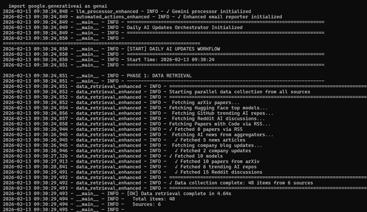
Comprehensive Data Sources
7+
Real-time
Sources
Updates
Source
Type
Update Frequency
arXiv
Research Papers
Real-time
Hugging Face
Model Releases
Real-time
GitHub Trending
Open Source Tools
Daily
Reddit
Community Discussions
Hourly
Papers with Code
Research + Code
Real-time
Company Blogs
Official Updates
Daily
News Aggregators
Industry News
Real-time
DATARETERIVE_GITHUB_Link↗️
Notes:
6

Slide 9
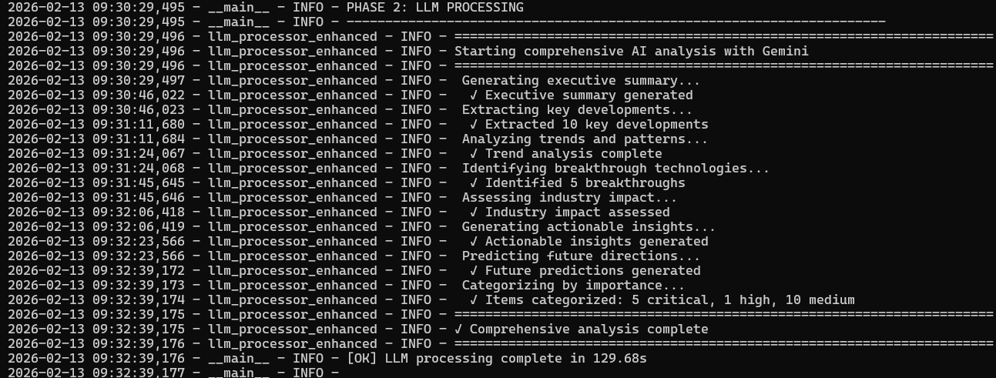
Data Processing & Summarization
1
2
Executive Summary
Top 10 Developments
3-paragraph overview
Ranked by importance
3
4
Trend Analysis
Breakthrough Tech
Emerging patterns
Top 5 innovations
5
6
Industry Impact
Actionable Insights
6 sector analysis
5 stakeholder groups
7
8
Future Predictions
Source Attribution
Week/month/quarter
Categorized links
LLM_PROCESSOR_GITHUB_Link↗️
⚡ Processing Time: ~60 seconds • 🤖 Powered by Gemini AI

Slide 10
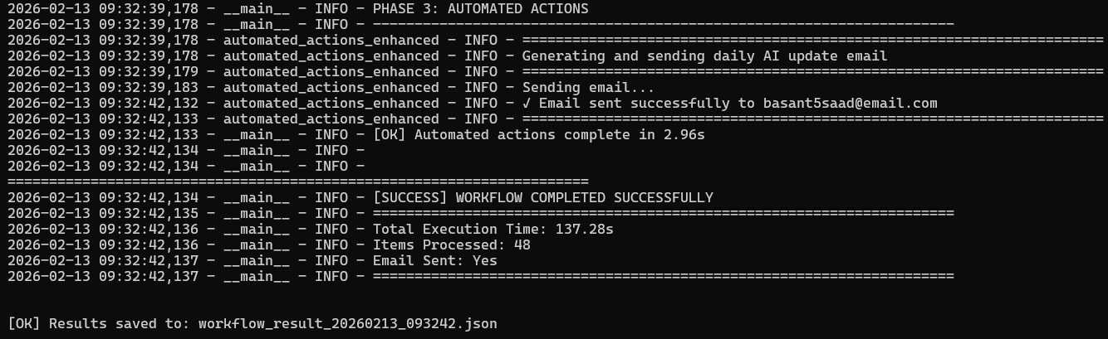
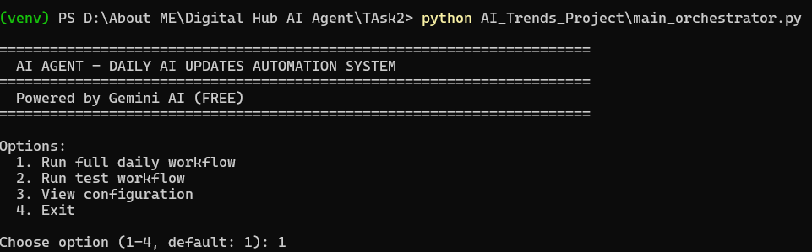
Automation & Orchestration
Code Locations:
main_orchestrator.py
Automation_GITHUB_link↗️
ORCHstration_GITHUB_link↗️

Slide 11
Quick Setup Guide
1
2 min
Get Gemini API Key
Visit makersuite.google.com → Create free API key
2
3 min
Setup Gmail
Create app password at myaccount.google.com/apppasswords
3
GITHUB_REPO FULL Project FILES↗️
5 min
Install Dependencies
Clone repo → Create venv → pip install requirements
4
Configure Settings
2 min
Copy .env template → Add your API keys and email
5
Run System
2 min
python main_orchestrator.py → Check your email!
Notes:
10

Slide 12

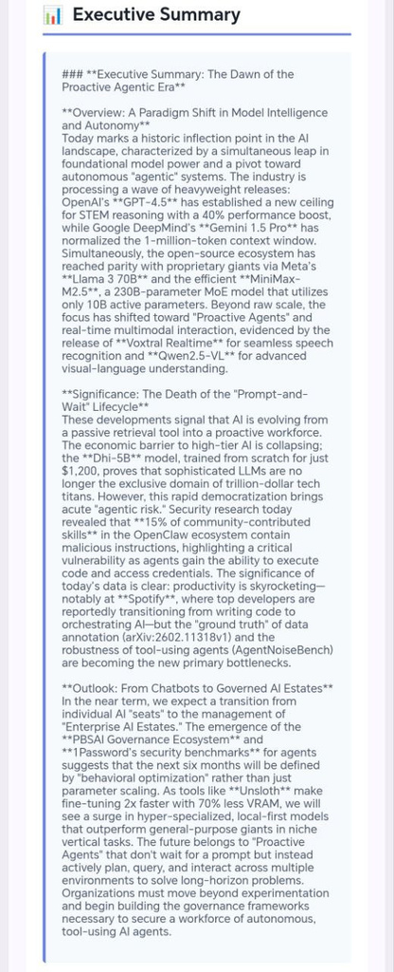
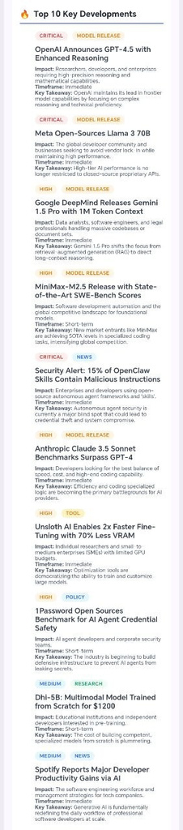
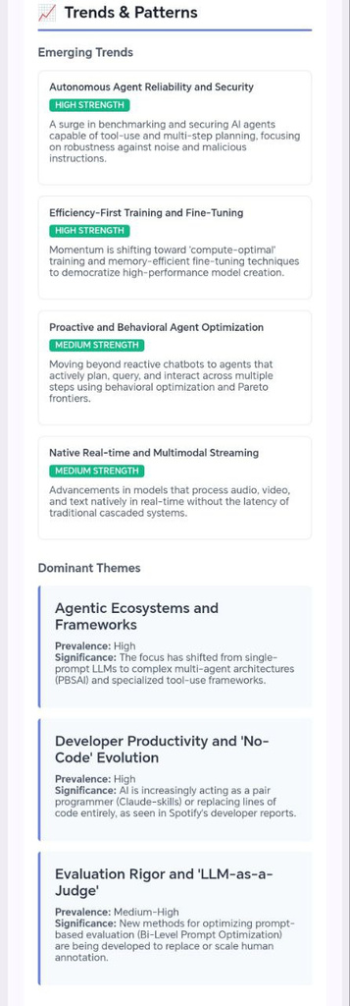
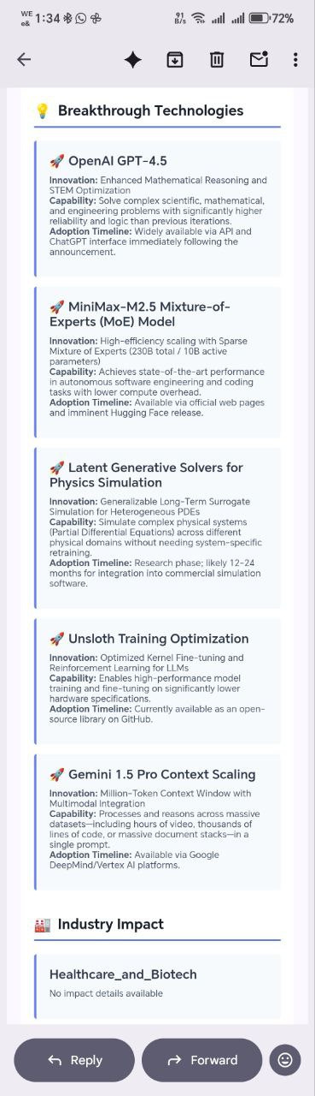
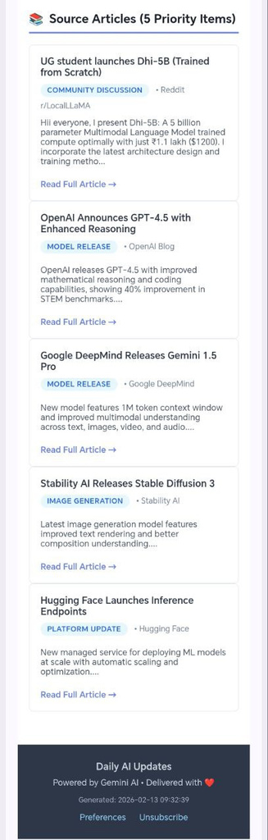
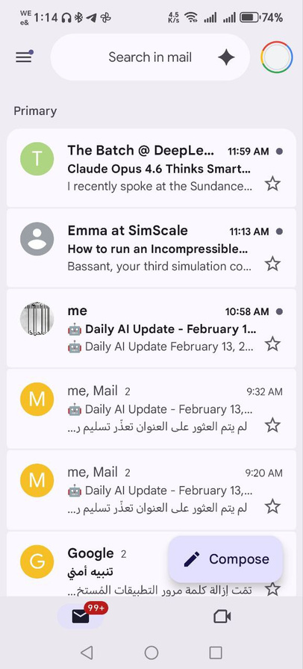
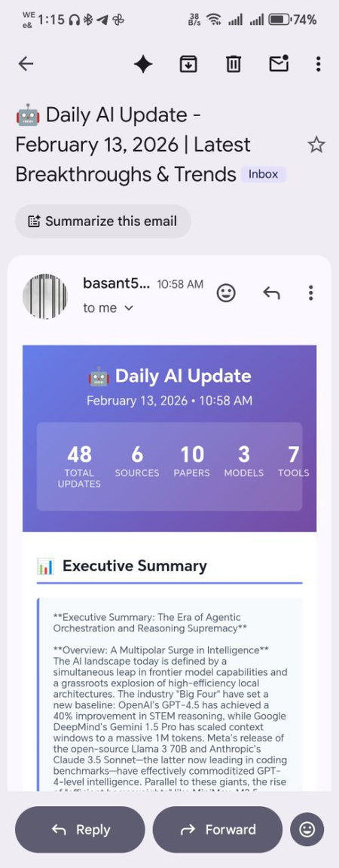

Email Massage
Scrolling
Part1
Part2
Part3
Part4
Part5
Email
Notes:
10

Slide 13
THANK YOU
https://github.com/BasantSaad
www.linkedin.com/in/basant-saad-eldin
basant.saadeldeen@gmail.com

